Slide 1
WELCOME

Slide 2

WELCOME
INTERNATIONAL YOUTH MATH CHALLENGE

Slide 3
WELCOME
INTERNATIONAL YOUTH MATH CHALLENGE

Slide 4
WHISPERING WOODS

Slide 5
Our Team
WELCOME

Slide 6
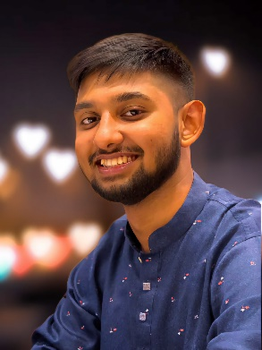

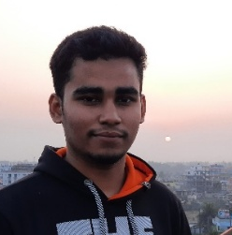
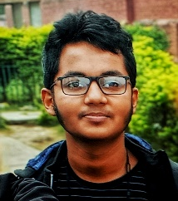


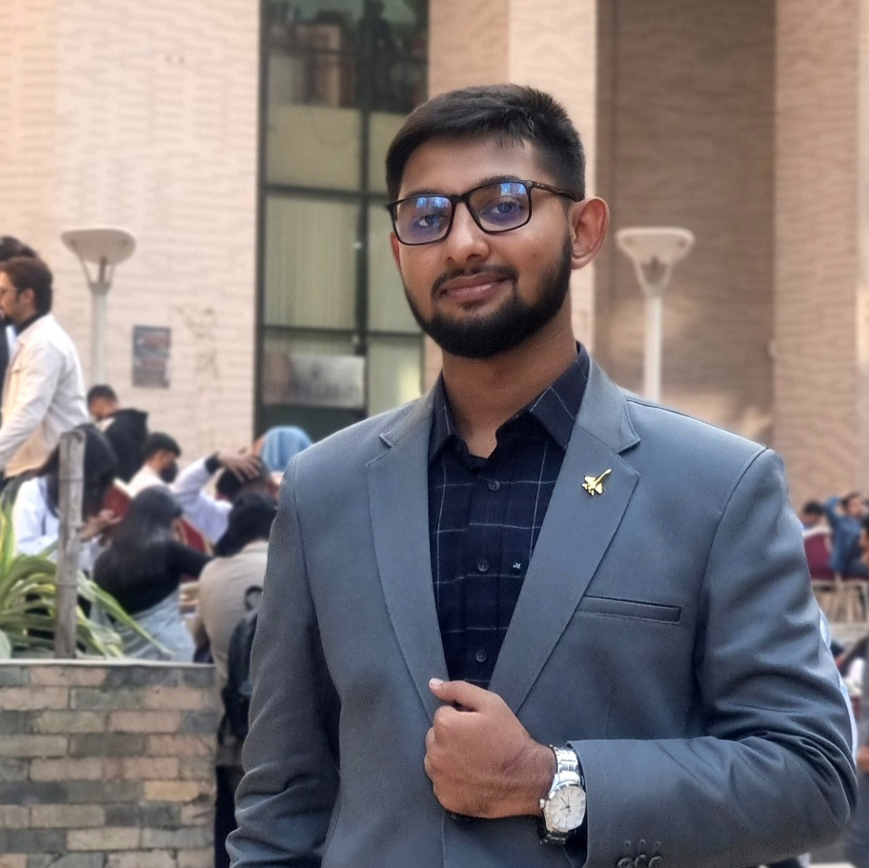



Our Team
Samia
Jannat
Audhira
Fahim
sterben.86
MD. FAHIM HOSSAIN
NSU ID: 2512847642
fahim.hossain.251@northsouth.edu

Slide 7



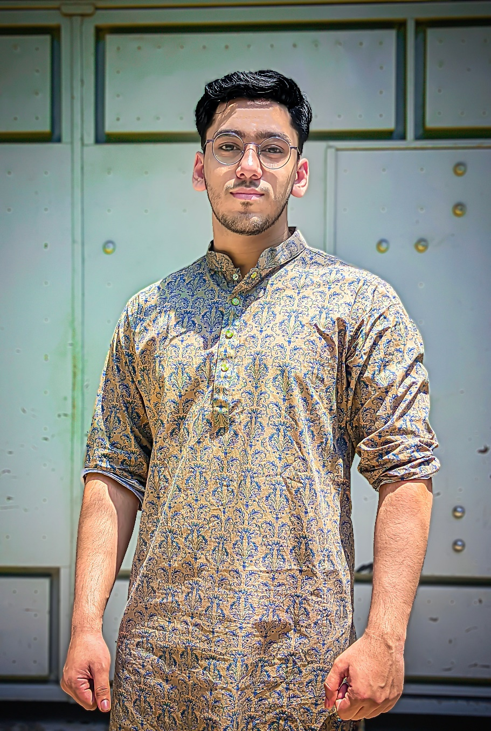


Our Team
Fahim
Arin
Shayikh
Siam
siam_672
SAMIA ZAMAN
TEAM CO-ORDINATOR
Specializing in problem-solving and computer science, I design impactful educational experiences. My scouting background reinforces me in leadership, discipline, and mentoring capabilities.
siam-rahman-85074420b
Siam

Slide 8
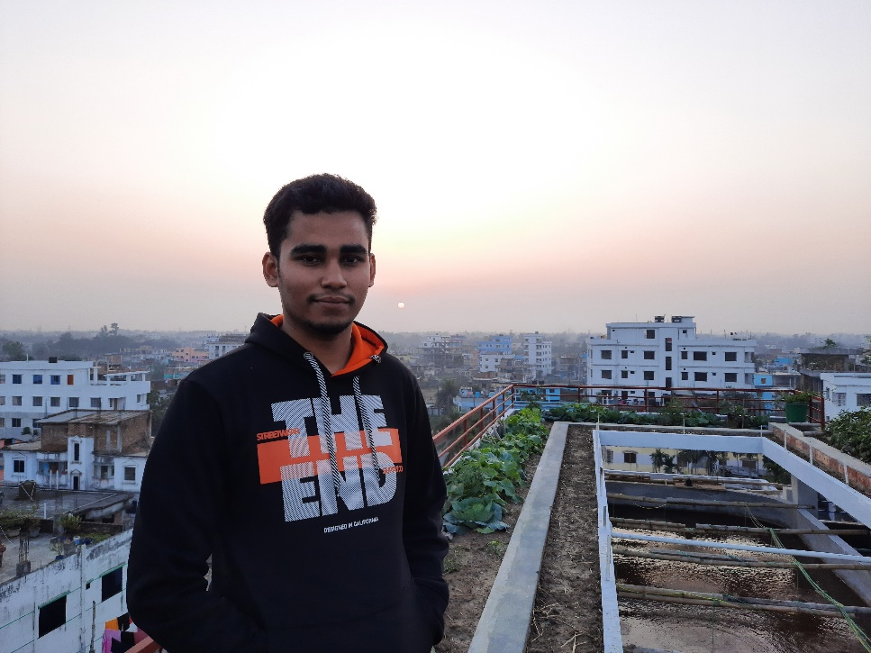

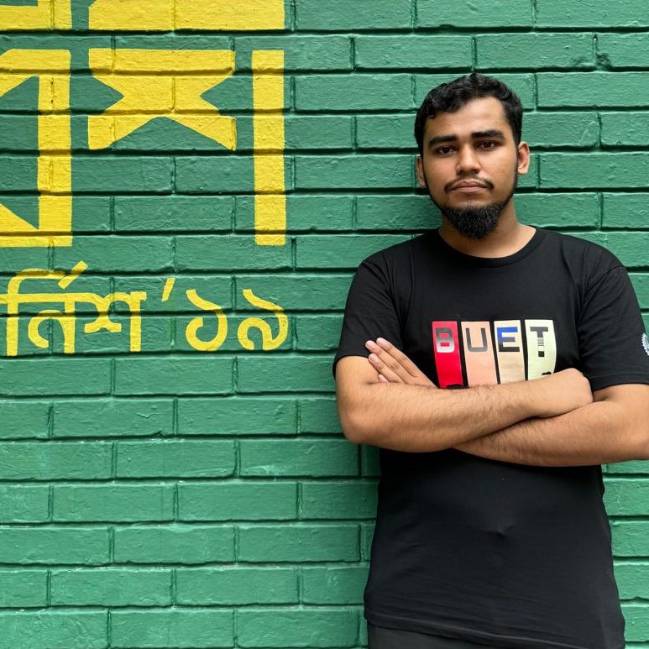
Our Team
Fahim
Siam
Shayikh
Arin
e_r_i_k251221
RIAZUL JANNAT
TEAM CO-ORDINATOR
Driven by curiosity and a passion for physics, I love experimentation and innovative problem-solving. I am committed to advancing the field while inspiring others through collaboration and inventive solutions.
aaa-alif-827256326
AL Arik (Arin)

Slide 9

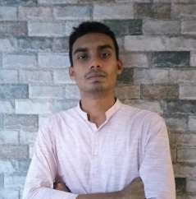


Our Team
Fahim
Siam
Sunnah
Shayikh
lucid_rhetoric_313
SIDRATUL MUNTAHARA AUDHIRA
NSU ID: 2513009642
md-shayikh-mostofa-9b44b8251

Slide 10

DISCOVER
WHISPERING WOODS

Slide 11
DISCOVER
WHISPERING WOODS

Slide 12
DISCOVER
WHISPERING WOODS

Slide 13
VISIONS & VALUES
To enable students from all countries to prove their math skills and to unleash their creativity

Slide 14
OUR EXCLUSIVENESS

Slide 15
OUR EXCLUSIVENESS
Internationality:
The International Youth Math Challenge is a global competition from the first round! All participants solve the same problems in every round: This enables a fair evaluation and international exchange.
Creative Problems:
The pre-final round includes two special problem types that only exist in the IYMC competition: the special-creativity-problems. This problem type represents real examples of mathematical research and requires special originality and advanced understanding of mathematics.
Online Submission:
The competition uses the possibilities of the modern internet to give all students the opportunity to participate regardless of nation, region, or school.

Slide 16
OUR EXCLUSIVENESS
Internationality:
The International Youth Math Challenge is a global competition from the first round! All participants solve the same problems in every round: This enables a fair evaluation and international exchange.
Creative Problems:
The pre-final round includes two special problem types that only exist in the IYMC competition: the special-creativity-problems. This problem type represents real examples of mathematical research and requires special originality and advanced understanding of mathematics.
Online Submission:
The competition uses the possibilities of the modern internet to give all students the opportunity to participate regardless of nation, region, or school.

Slide 17
OUR EXCLUSIVENESS
Internationality:
The International Youth Math Challenge is a global competition from the first round! All participants solve the same problems in every round: This enables a fair evaluation and international exchange.
Creative Problems:
The pre-final round includes two special problem types that only exist in the IYMC competition: the special-creativity-problems. This problem type represents real examples of mathematical research and requires special originality and advanced understanding of mathematics.
Online Submission:
The competition uses the possibilities of the modern internet to give all students the opportunity to participate regardless of nation, region, or school.

Slide 18
OUR EXCLUSIVENESS
Internationality:
The International Youth Math Challenge is a global competition from the first round! All participants solve the same problems in every round: This enables a fair evaluation and international exchange.
Creative Problems:
The pre-final round includes two special problem types that only exist in the IYMC competition: the special-creativity-problems. This problem type represents real examples of mathematical research and requires special originality and advanced understanding of mathematics.
Online Submission:
The competition uses the possibilities of the modern internet to give all students the opportunity to participate regardless of nation, region, or school.

Slide 19
OUR EXCLUSIVENESS

Slide 20
PARTICIPANTS

Slide 21


JUNIOR CATEGORY (under 18 years)
To qualify for the pre-final round, students have to solve minimum three problems correctly
PARTICIPANTS

Slide 22
YOUTH CATEGORY (above 18 years)
To qualify for the pre-final round, students have to solve minimum four problems correctly
PARTICIPANTS

Slide 23
PARTICIPANTS

Slide 24
ACHIEVEMENTS & ACCOMPLISHMENTS

Slide 25




ACHIEVEMENTS & ACCOMPLISHMENTS

Slide 26
ACHIEVEMENTS & ACCOMPLISHMENTS

Slide 27
ACHIEVEMENTS & ACCOMPLISHMENTS

Slide 28
ACHIEVEMENTS & ACCOMPLISHMENTS
FOR ALL FINALISTS

Slide 29
ACHIEVEMENTS & ACCOMPLISHMENTS
FOR ALL FINALISTS

Slide 30
ACHIEVEMENTS & ACCOMPLISHMENTS

Slide 31
INTERNATIONAL YOUTH MATH CHALLENGE

Slide 33
WELCOME
INTERNATIONAL YOUTH MATH CHALLENGE

Slide 34
BUT THAT’S
NOT ALL

Slide 35
NATIONAL AWARD
AN HONOUR FOR THE BEST PARTICIPANT FROM OUR COUNTRY

Slide 36
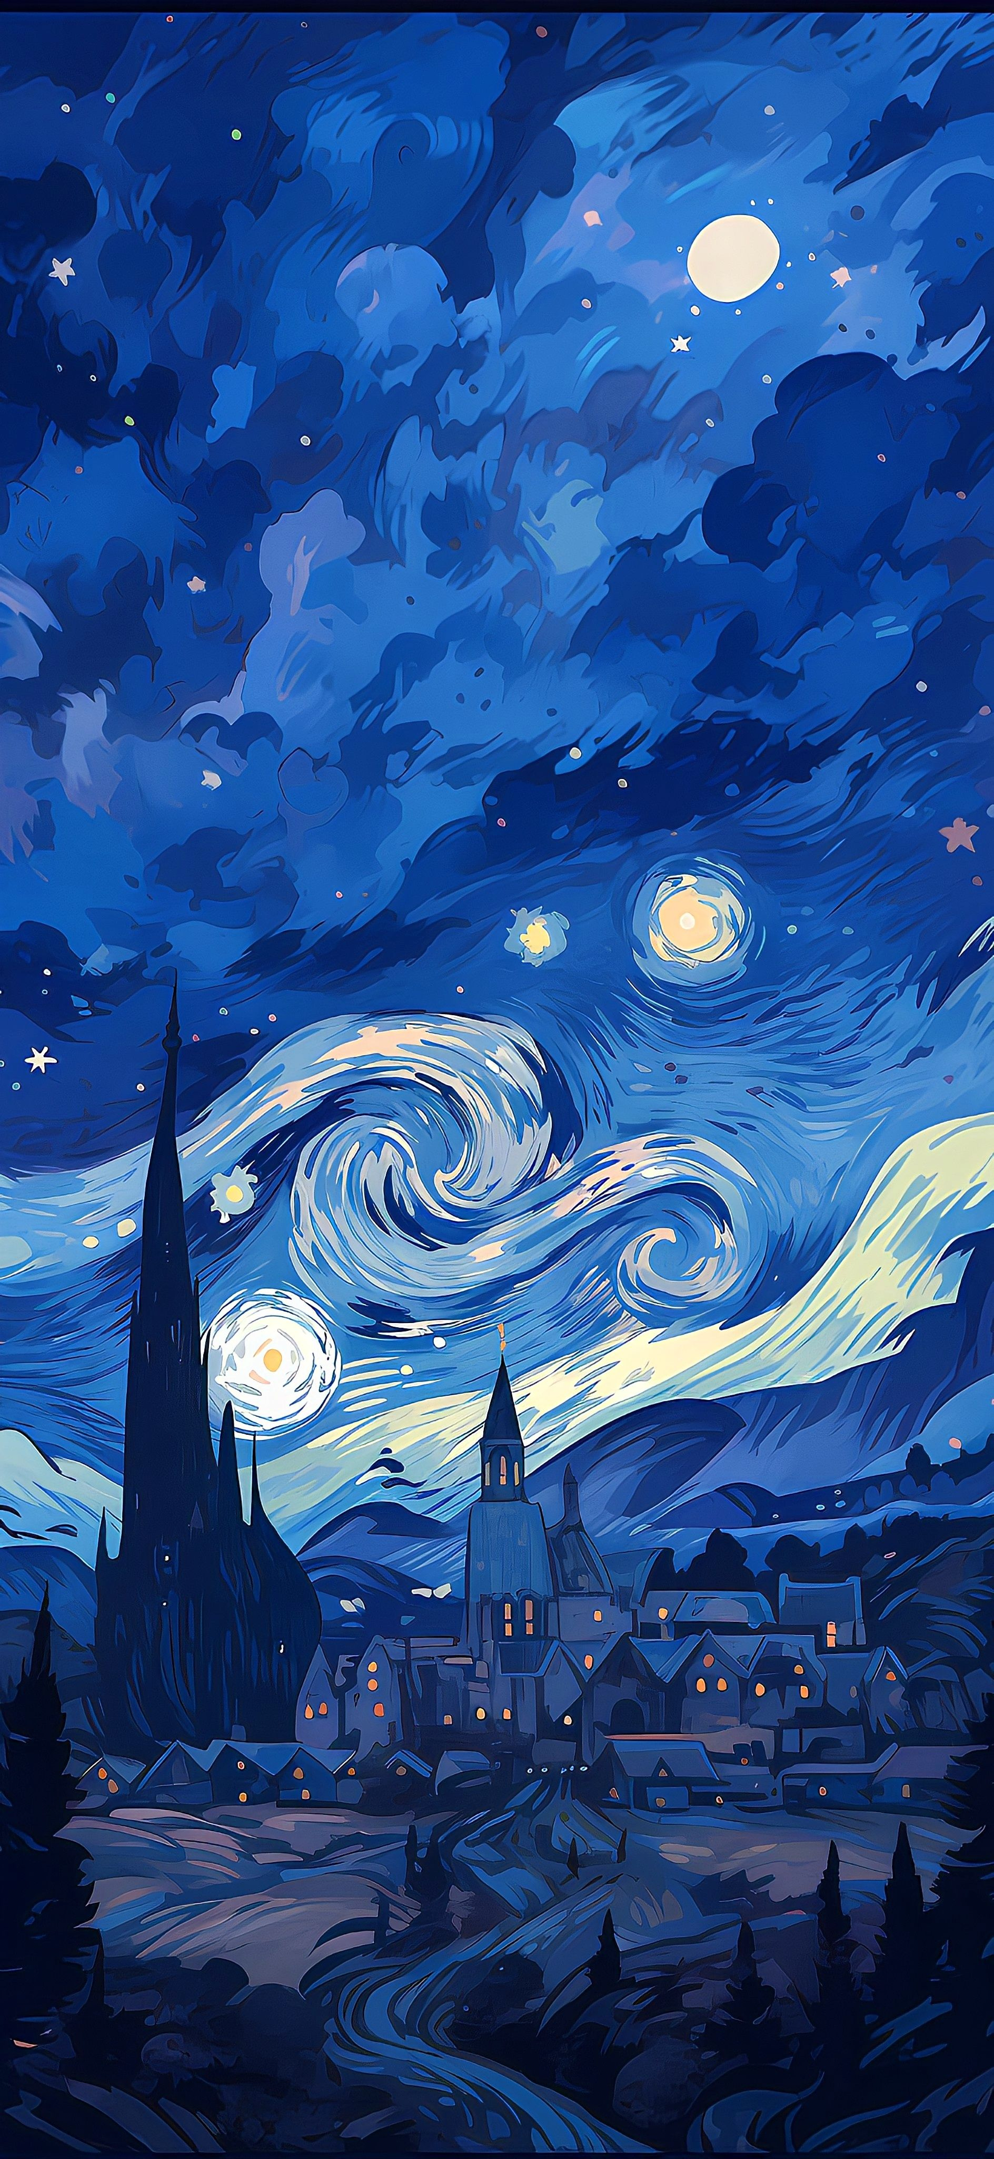
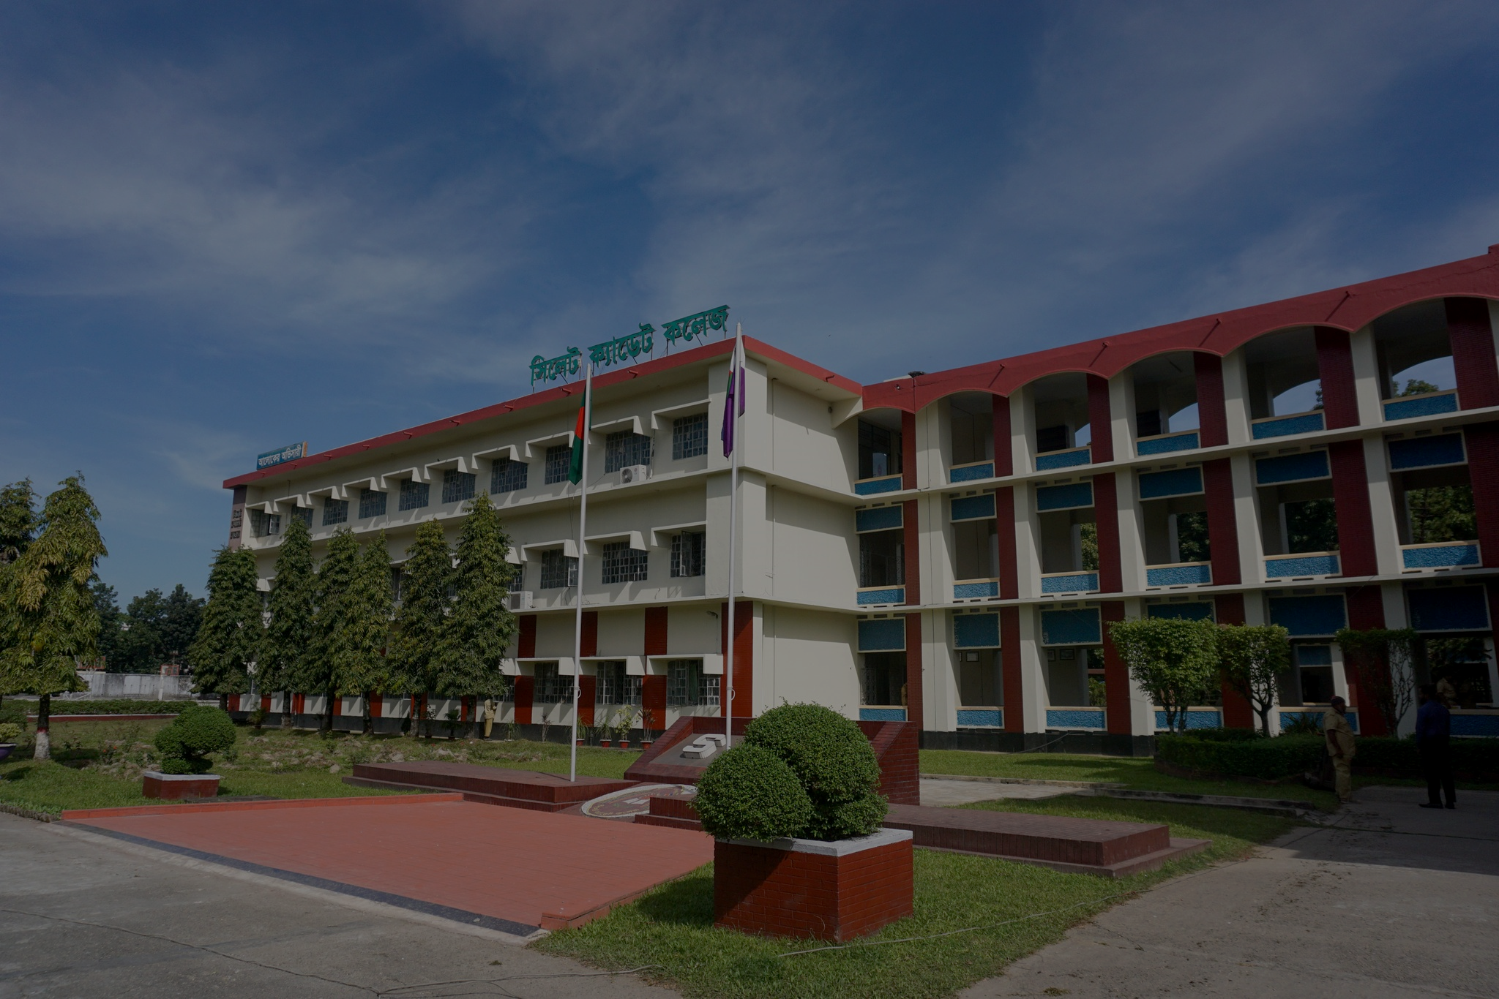
SCHOOL AWARDS
SCHOOL AWARDS
We honor the vital role of teachers and schools in mathematical education through three prestigious awards recognizing their dedication and impact.
IYMC School Award for Most Participants
IYMC School Award for Most Finalists
IYMC School Award for Excellence

Slide 37
SCHOOL AWARDS
SCHOOL AWARDS
We honor the vital role of teachers and schools in mathematical education through three prestigious awards recognizing their dedication and impact.
IYMC School Award for Most Participants
IYMC School Award for Most Finalists
IYMC School Award for Excellence

Slide 38
ACHIEVEMENTS & ACCOMPLISHMENTS

Slide 39
PROGRESSION TIERS

Slide 40

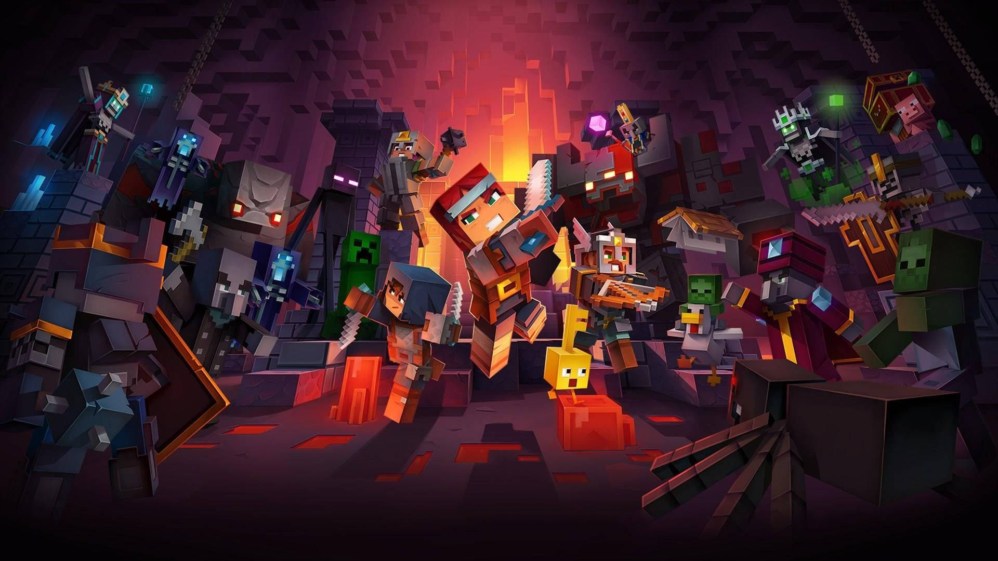
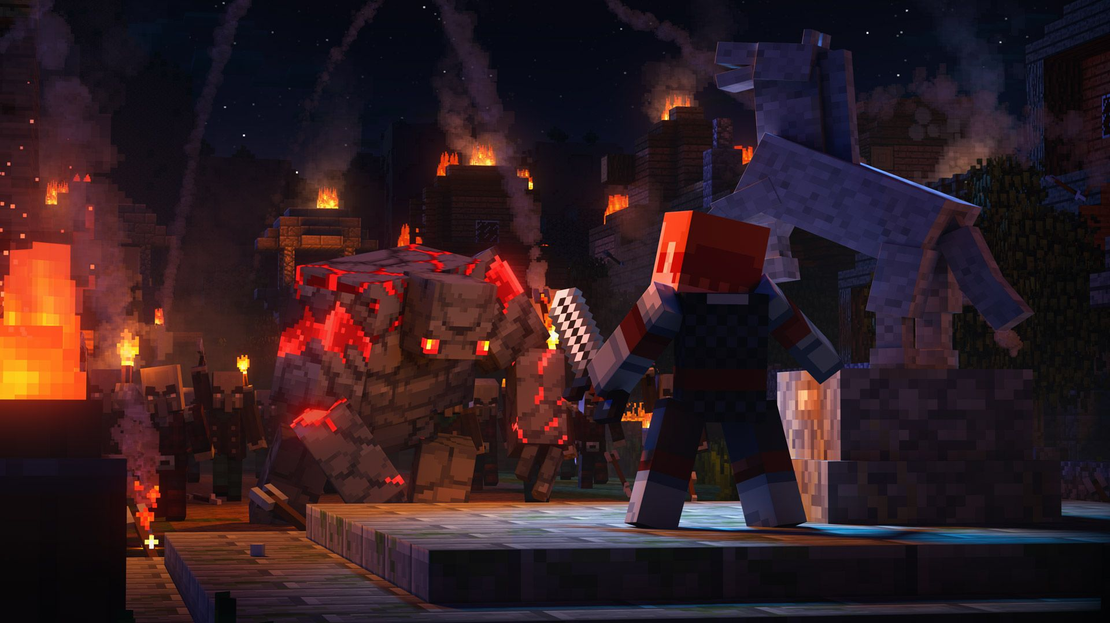
QUALIFICATION ROUND
PRE-FINAL
ROUND
FINAL
ROUND

Slide 41
QUALIFICATION ROUND
PRE-FINAL
ROUND
FINAL
ROUND

Slide 42
Rules:
Access the problems on the official IYMC website.
Beat the clock and submit your answers before the deadline
Your file can be either typed digitally (recommended) or a clear picture of your handwritten work. If you have multiple pictures, merge them into a single file to make your submission complete!
Quest Overview
Your math journey begins with the Qualification Round, the first stage of your quest to become a math champion! You must solve five math challenges labeled A, B, C, D, and E. Each problem will test your mind and skills, with topics ranging from geometry to number theory.
Rules:
Access the problems on the official IYMC website.
Beat the clock and submit your answers before the deadline
Your file can be either typed digitally (recommended) or a clear picture of your handwritten work. If you have multiple pictures, merge them into a single file to make your submission complete!

Slide 43

Quest Overview
Your math journey begins with the Qualification Round, the first stage of your quest to become a math champion! You must solve five math challenges labeled A, B, C, D, and E. Each problem will test your mind and skills, with topics ranging from geometry to number theory.
Rules:
Access the problems on the official IYMC website.
Beat the clock and submit your answers before the deadline
Your file can be either typed digitally (recommended) or a clear picture of your handwritten work. If you have multiple pictures, merge them into a single file to make your submission complete!

Slide 44
Quest Overview
Your math journey begins with the Qualification Round, the first stage of your quest to become a math champion! You must solve five math challenges labeled A, B, C, D, and E. Each problem will test your mind and skills, with topics ranging from geometry to number theory.
Rules:
Access the problems on the official IYMC website.
Beat the clock and submit your answers before the deadline
Your file can be either typed digitally (recommended) or a clear picture of your handwritten work. If you have multiple pictures, merge them into a single file to make your submission complete!
submission deadline
16 December 2024 05:59
Result
23 December 2024

Slide 45
Rules:
Access the problems on the official IYMC website.
Beat the clock and submit your answers before the deadline
Your file can be either typed digitally (recommended) or a clear picture of your handwritten work. If you have multiple pictures, merge them into a single file to make your submission complete!
Quest Overview
Your math journey begins with the Qualification Round, the first stage of your quest to become a math champion! You must solve five math challenges labeled A, B, C, D, and E. Each problem will test your mind and skills, with topics ranging from geometry to number theory.
submission deadline
16 December 2024 05:59
Result
23 December 2024

Slide 46
QUALIFICATION ROUND
PRE-FINAL
ROUND
FINAL
ROUND

Slide 47
QUALIFICATION ROUND
PRE-FINAL
ROUND
FINAL
ROUND

Slide 48
Quest Overview
For this level, to advance to the Final Round, you need to reach:
18 points (if you're under 18 years old)
24 points (if you're over 18 years old)
You can score up to 36 points in total.
QUALIFICATION ROUND
PRE-FINAL
ROUND
FINAL
ROUND

Slide 49
Suppose, there is 20 lockers in a hall room. And there are 20 students.
01
02
03
04
05
06
07
08
09
10
11
12
13
14
15
16
17
18
19
20

Slide 50
1st student opened all the lockers
2nd student closed the locker numbered 2,4,6,8…

Slide 51
3rd student opens the lockers 3, 6, 9, 12… numbered
4th student closes the lockers 4, 8, 12, 16… numbered.
https://1drv.ms/p/s!AupDTulzvo3RgRrHk1r2EPmM9qX_
In this way, the students opens the lockers if it is closed and vice versa that are numbered by the multiples of the corresponding student number.

Slide 52
All the students continue in this way.
Now the question is, which numbered lockers will remain opened?

Slide 53
Quest Overview
For this level, to advance to the Final Round, you need to reach:
18 points (if you're under 18 years old)
24 points (if you're over 18 years old)
You can score up to 36 points in total.
QUALIFICATION ROUND
PRE-FINAL
ROUND
FINAL
ROUND

Slide 54
Quest Overview
For this level, to advance to the Final Round, you need to reach:
18 points (if you're under 18 years old)
24 points (if you're over 18 years old)
You can score up to 36 points in total.
The Quest
2x Basic Puzzles:
4 points each.
2x Advanced Puzzles:
6 points each.
2x Special-Creativity Puzzles:
The ultimate boss battles! There's no single correct answer here—your creativity and strategy could earn you between 0 to 8 points!

Slide 55
Quest Overview
For this level, to advance to the Final Round, you need to reach:
18 points (if you're under 18 years old)
24 points (if you're over 18 years old)
You can score up to 36 points in total.
The Quest
2x Basic Puzzles:
4 points each.
2x Advanced Puzzles:
6 points each.
2x Special-Creativity Puzzles:
The ultimate boss battles! There's no single correct answer here—your creativity and strategy could earn you between 0 to 8 points!
JOIN THE GUILD:
To continue your journey, you need to register for the Pre-Final Round with fee of 8 EUR before Tuesday, January 14, 2025.
RACE AGAINST TIME
Your mission begins on Thursday, January 16, 2025. You’ll have 4 days to conquer these puzzles before the final horn sounds on Sunday, January 19, 2025.

Slide 56
The Quest
2x Basic Puzzles:
4 points each.
2x Advanced Puzzles:
6 points each.
2x Special-Creativity Puzzles:
The ultimate boss battles! There's no single correct answer here—your creativity and strategy could earn you between 0 to 8 points!
Quest Overview
For this level, to advance to the Final Round, you need to reach:
18 points (if you're under 18 years old)
24 points (if you're over 18 years old)
You can score up to 36 points in total.
JOIN THE GUILD:
To continue your journey, you need to register for the Pre-Final Round with fee of 8 EUR before Tuesday, January 14, 2025.
RACE AGAINST TIME
Your mission begins on Thursday, January 16, 2025. You’ll have 4 days to conquer these puzzles before the final horn sounds on Sunday, January 19, 2025.
QUEST START
16 January 2025
submission deadline
19 January 2025
Result
27 January 2025

Slide 57
JOIN THE GUILD:
To continue your journey, you need to register for the Pre-Final Round with fee of 8 EUR before Tuesday, January 14, 2025.
RACE AGAINST TIME
Your mission begins on Thursday, January 16, 2025. You’ll have 4 days to conquer these puzzles before the final horn sounds on Sunday, January 19, 2025.
The Quest
2x Basic Puzzles:
4 points each.
2x Advanced Puzzles:
6 points each.
2x Special-Creativity Puzzles:
The ultimate boss battles! There's no single correct answer here—your creativity and strategy could earn you between 0 to 8 points!
Quest Overview
For this level, to advance to the Final Round, you need to reach:
18 points (if you're under 18 years old)
24 points (if you're over 18 years old)
You can score up to 36 points in total.
QUEST START
16 January 2025
submission deadline
19 January 2025
Result
27 January 2025

Slide 58
QUALIFICATION ROUND
PRE-FINAL
ROUND
FINAL
ROUND

Slide 59
QUALIFICATION ROUND
PRE-FINAL
ROUND
FINAL
ROUND

Slide 60
Quest Overview
x20 multiple choice questions.
1 point each question
60 seconds for each
QUALIFICATION ROUND
PRE-FINAL
ROUND
FINAL
ROUND

Slide 61
Quest Overview
x20 multiple choice questions.
1 point each question
60 seconds for each
TEACHER
SUPERVITION
All finalists have to select a official IYMC teacher who agrees to supervise the final exam to ensure fairness

Slide 62
Quest Overview
x20 multiple choice questions.
1 point each question
60 seconds for each
TEACHER
SUPERVITION
All finalists have to select a official IYMC teacher who agrees to supervise the final exam to ensure fairness
EXAM DATE
11 February 2025
6PM-7PM
Result
17 February 2025

Slide 63
TEACHER
SUPERVITION
Quest Overview
All finalists have to select a official IYMC teacher who agrees to supervise the final exam to ensure fairness
x20 multiple choice questions.
1 point each question
60 seconds for each
EXAM DATE
11 February 2025
6PM-7PM
Result
17 February 2025

Slide 64
QUALIFICATION ROUND
PRE-FINAL
ROUND
FINAL
ROUND

Slide 65
PROGRESSION TIERS

Slide 66

THE JOURNEY ENDS
ANY QUESTIONS ??

Slide 67
ANY QUESTIONS ??

Slide 69
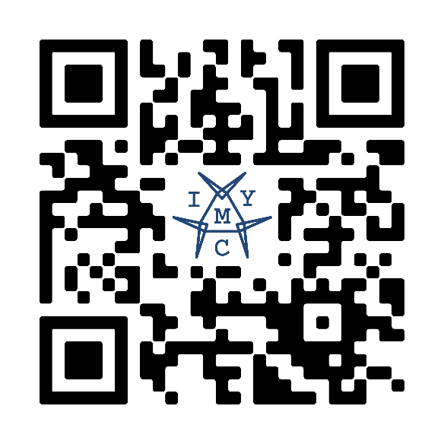



+8801300605674
fahhossain@amb.iymc.info
CONTACT US
Submit Your Answer
www.iymc.info/amb/fahhossain

Slide 70


Slide 71


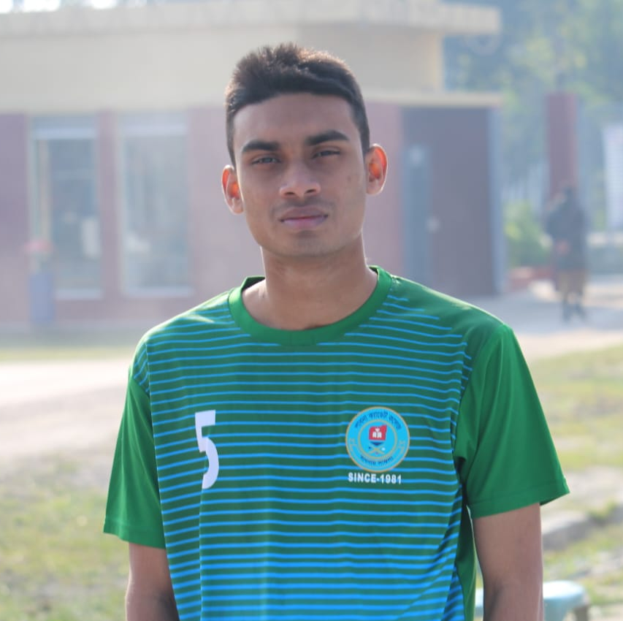
Our Team
Fahim
Siam
Sunnah
Shayikh
sunnah_75
TANVIR SUNNAH
TEAM CO-ORDINATOR
Driven by curiosity and a passion for math, I love experimentation and innovative problem-solving. I am committed to advancing the field while inspiring others through collaboration and inventive solutions.
tanvir-sunnah-594235314
Tanvir Sunnah

